Slide 1


FIND YOUR LAWYER
Information Technology Department
Laxmi Institute of Technology, Sarigam
Guided by
Ms. Kavita Joshi
Presented by
Chetan Borase (170860116003) Ratan Chaurasiya (170860116004)
Dhiraj Prajapati (170860116020)
Sanjay Prajapati (170860116021)

Slide 2
CONTENTS
Abstract
Literature Survey
Proposed Solution
UML Diagrams
Database Design
Implementation
Conclusion & Future Work
References

Slide 3
Abstract
There are many law firms working but let's talk about India, there are many lawyers(20 lakh approx.) currently present here with jobs and without jobs or are working under someone else. If a person has to seek a lawyer he doesn't know where to go until he/she has some connections or contact with higher authorities. So it's a bit of a mess to go for the right decision because it includes your time and money. So to make this convenient we are developing an app called “Find your lawyer” which will eliminate the problems. This app will help the client to get lawyers and lawyers to get clients. People having no contact in this field will easily be able to hire a lawyer without any mess. We will bring all types of lawyers at one single platform so no need to go here and there to seek one . One can book an appointment with the lawyer at a single click without any hesitation as all the lawyers are verified. After the peaceful meeting they can go for the next step. This also has a complaint feature which will be helpful to identify the fake clients and lawyers. Lawyers can maintain the records easily and effectively. Lawyers can ask to upload the documents online required for the cases from the client so no need to go to a lawyers firm .This will also have a live chat feature for the client and lawyer for the betterment of them. This system will help to save the money and time of the people. The clients or lawyers can reschedule the appointments according to his/her convenience. This helps the new layers to get a chance to handle the variety cases and increase their experience and prove the capability of them. The client can rate the lawyer which helps him to get more clients.

Slide 4
Literature survey
Legalmatch (website)
Vkeel (app)
Lawrato (website)

Slide 5
Keypoints | LegalMatch(website) | LawRato(website) | Vkeel(app)
Availability | Not in India | Available in India (not in all cities) | Available in India (not in all cities)
Category | Maximum law categories | Maximum law categories | Maximum law categories
Chat between client and lawyer | No | No | No
Response time | Depends on lawyer till its pending | Can contact directly | Can contact directly
Ask question (free legal advice) | Available | Available | Available
Live customer support | No | Yes | No
Number of lawyers available | Not defined | 10k+ | 10k+
Lawyer profile visibility | Can be seen after the confirmation | Can be seen | Can be seen
Complaint system | Can be done through email only | Can be done through email only | Can be done through email only
User experience | complex | average | Simple

Slide 6
Proposed solution
Available in india
Chat system between client and lawyer
Free advisory services through qnA FORUM
Less response time
Full visibility of lawyers profile
Complaint system
Simple user experience

Slide 7
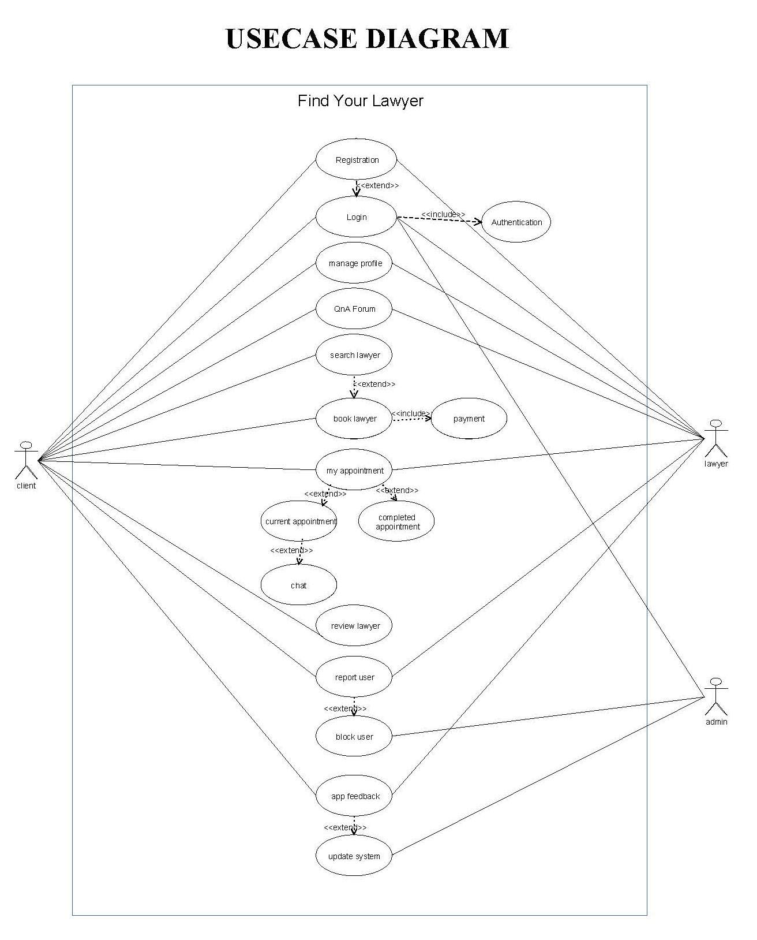
UML Diagrams
Usecase Diagram

Slide 8
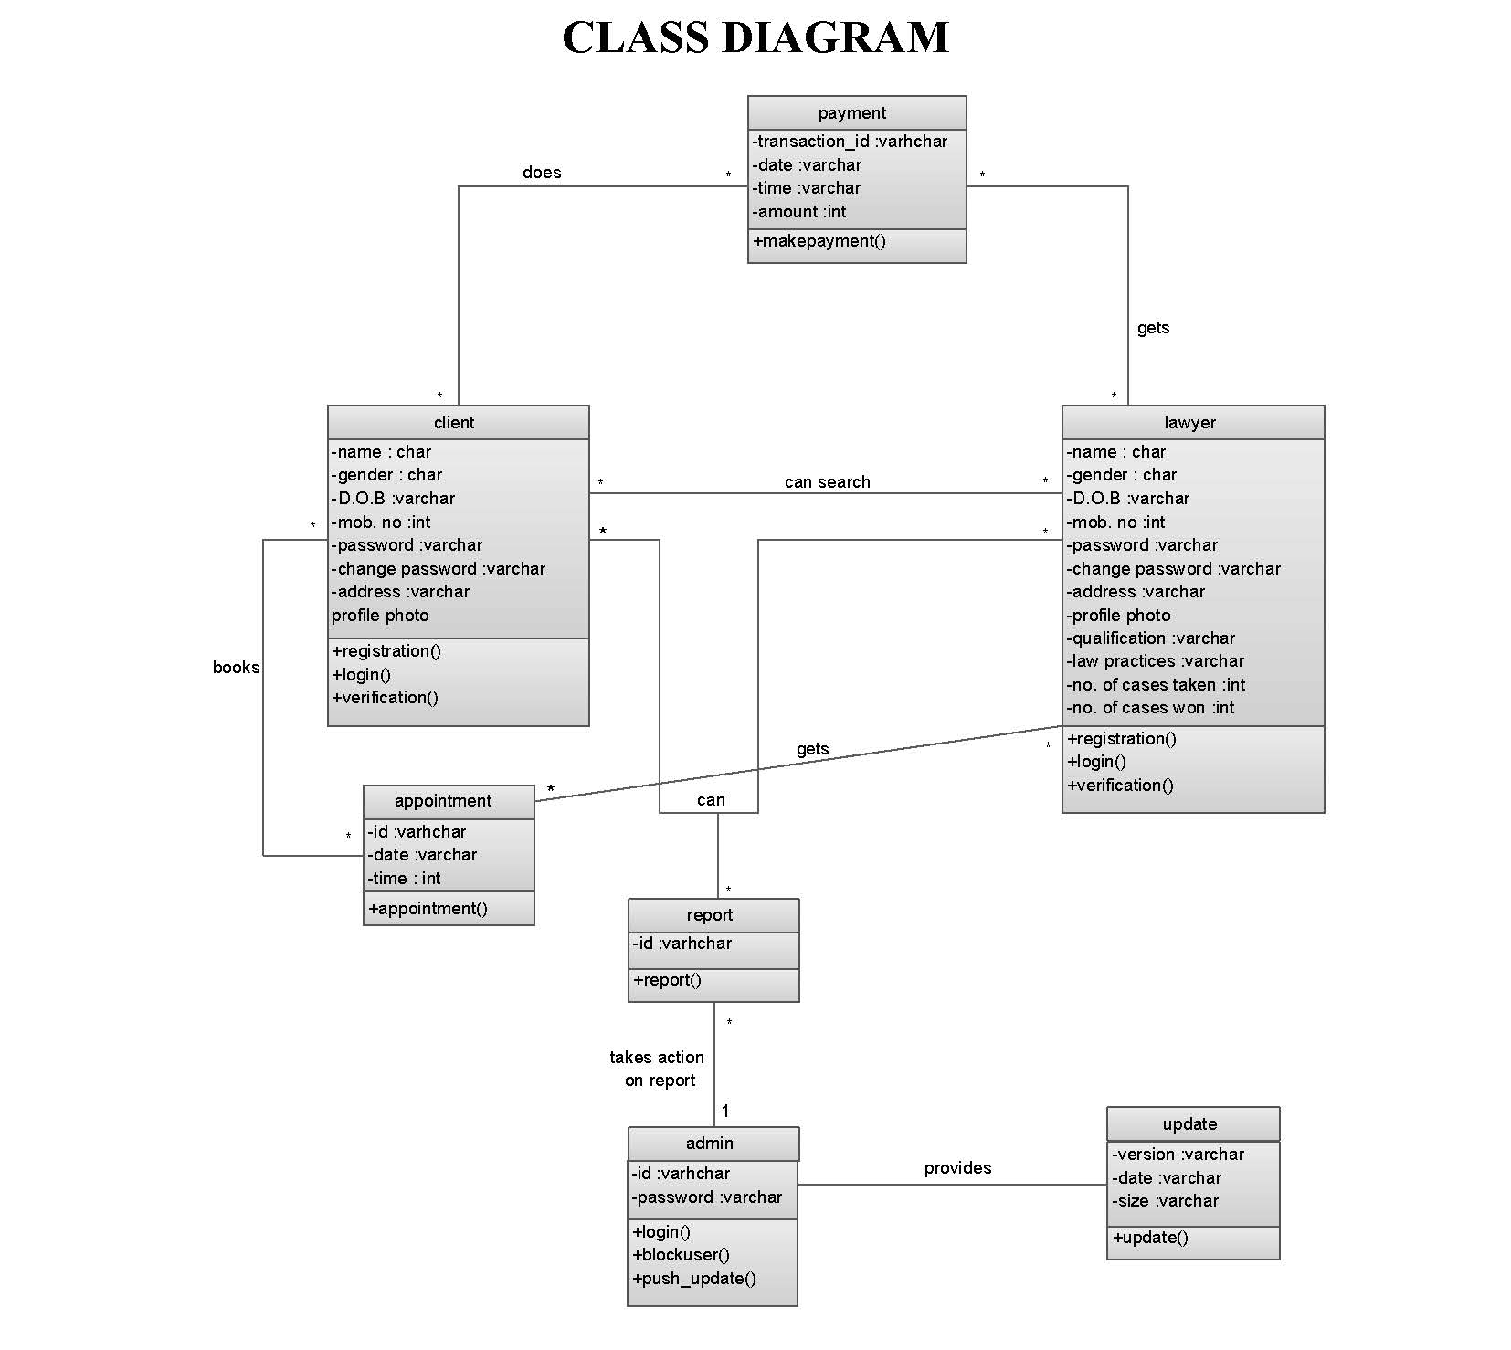
Class Diagram

Slide 9
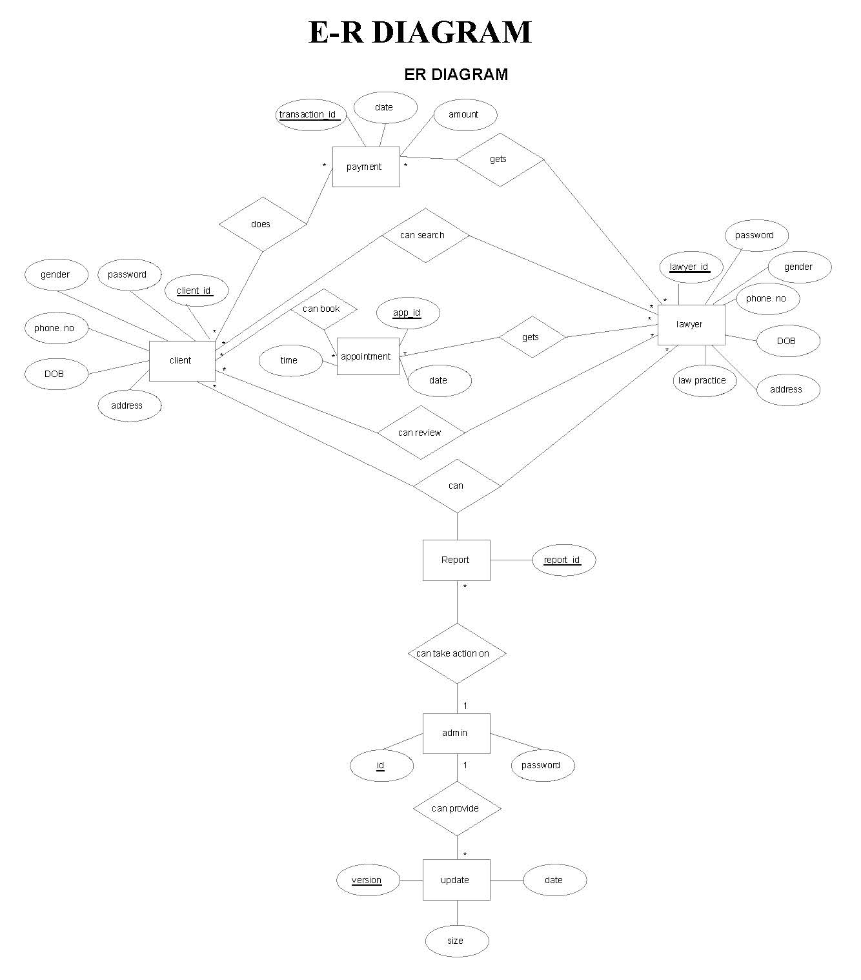
E-R Diagram

Slide 10
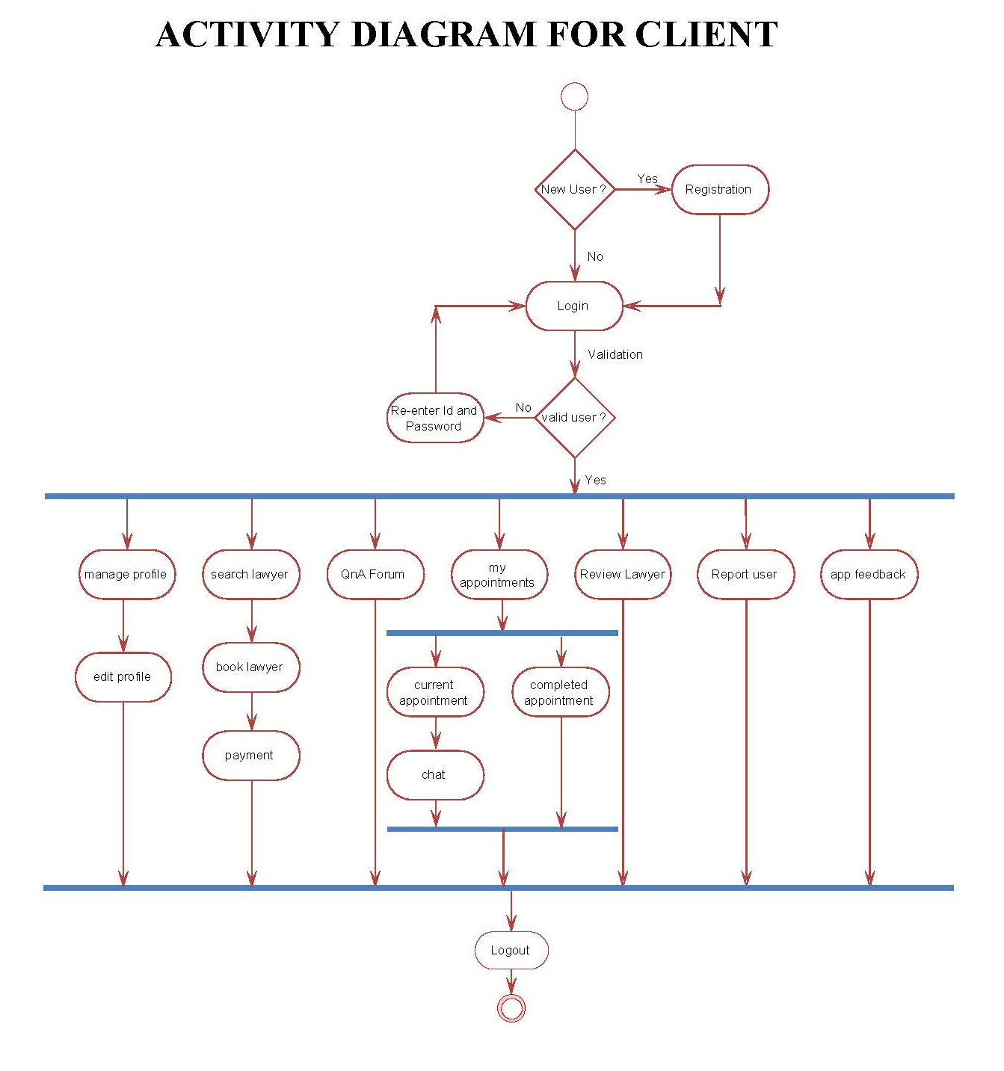
Activity Diagram For Client

Slide 11
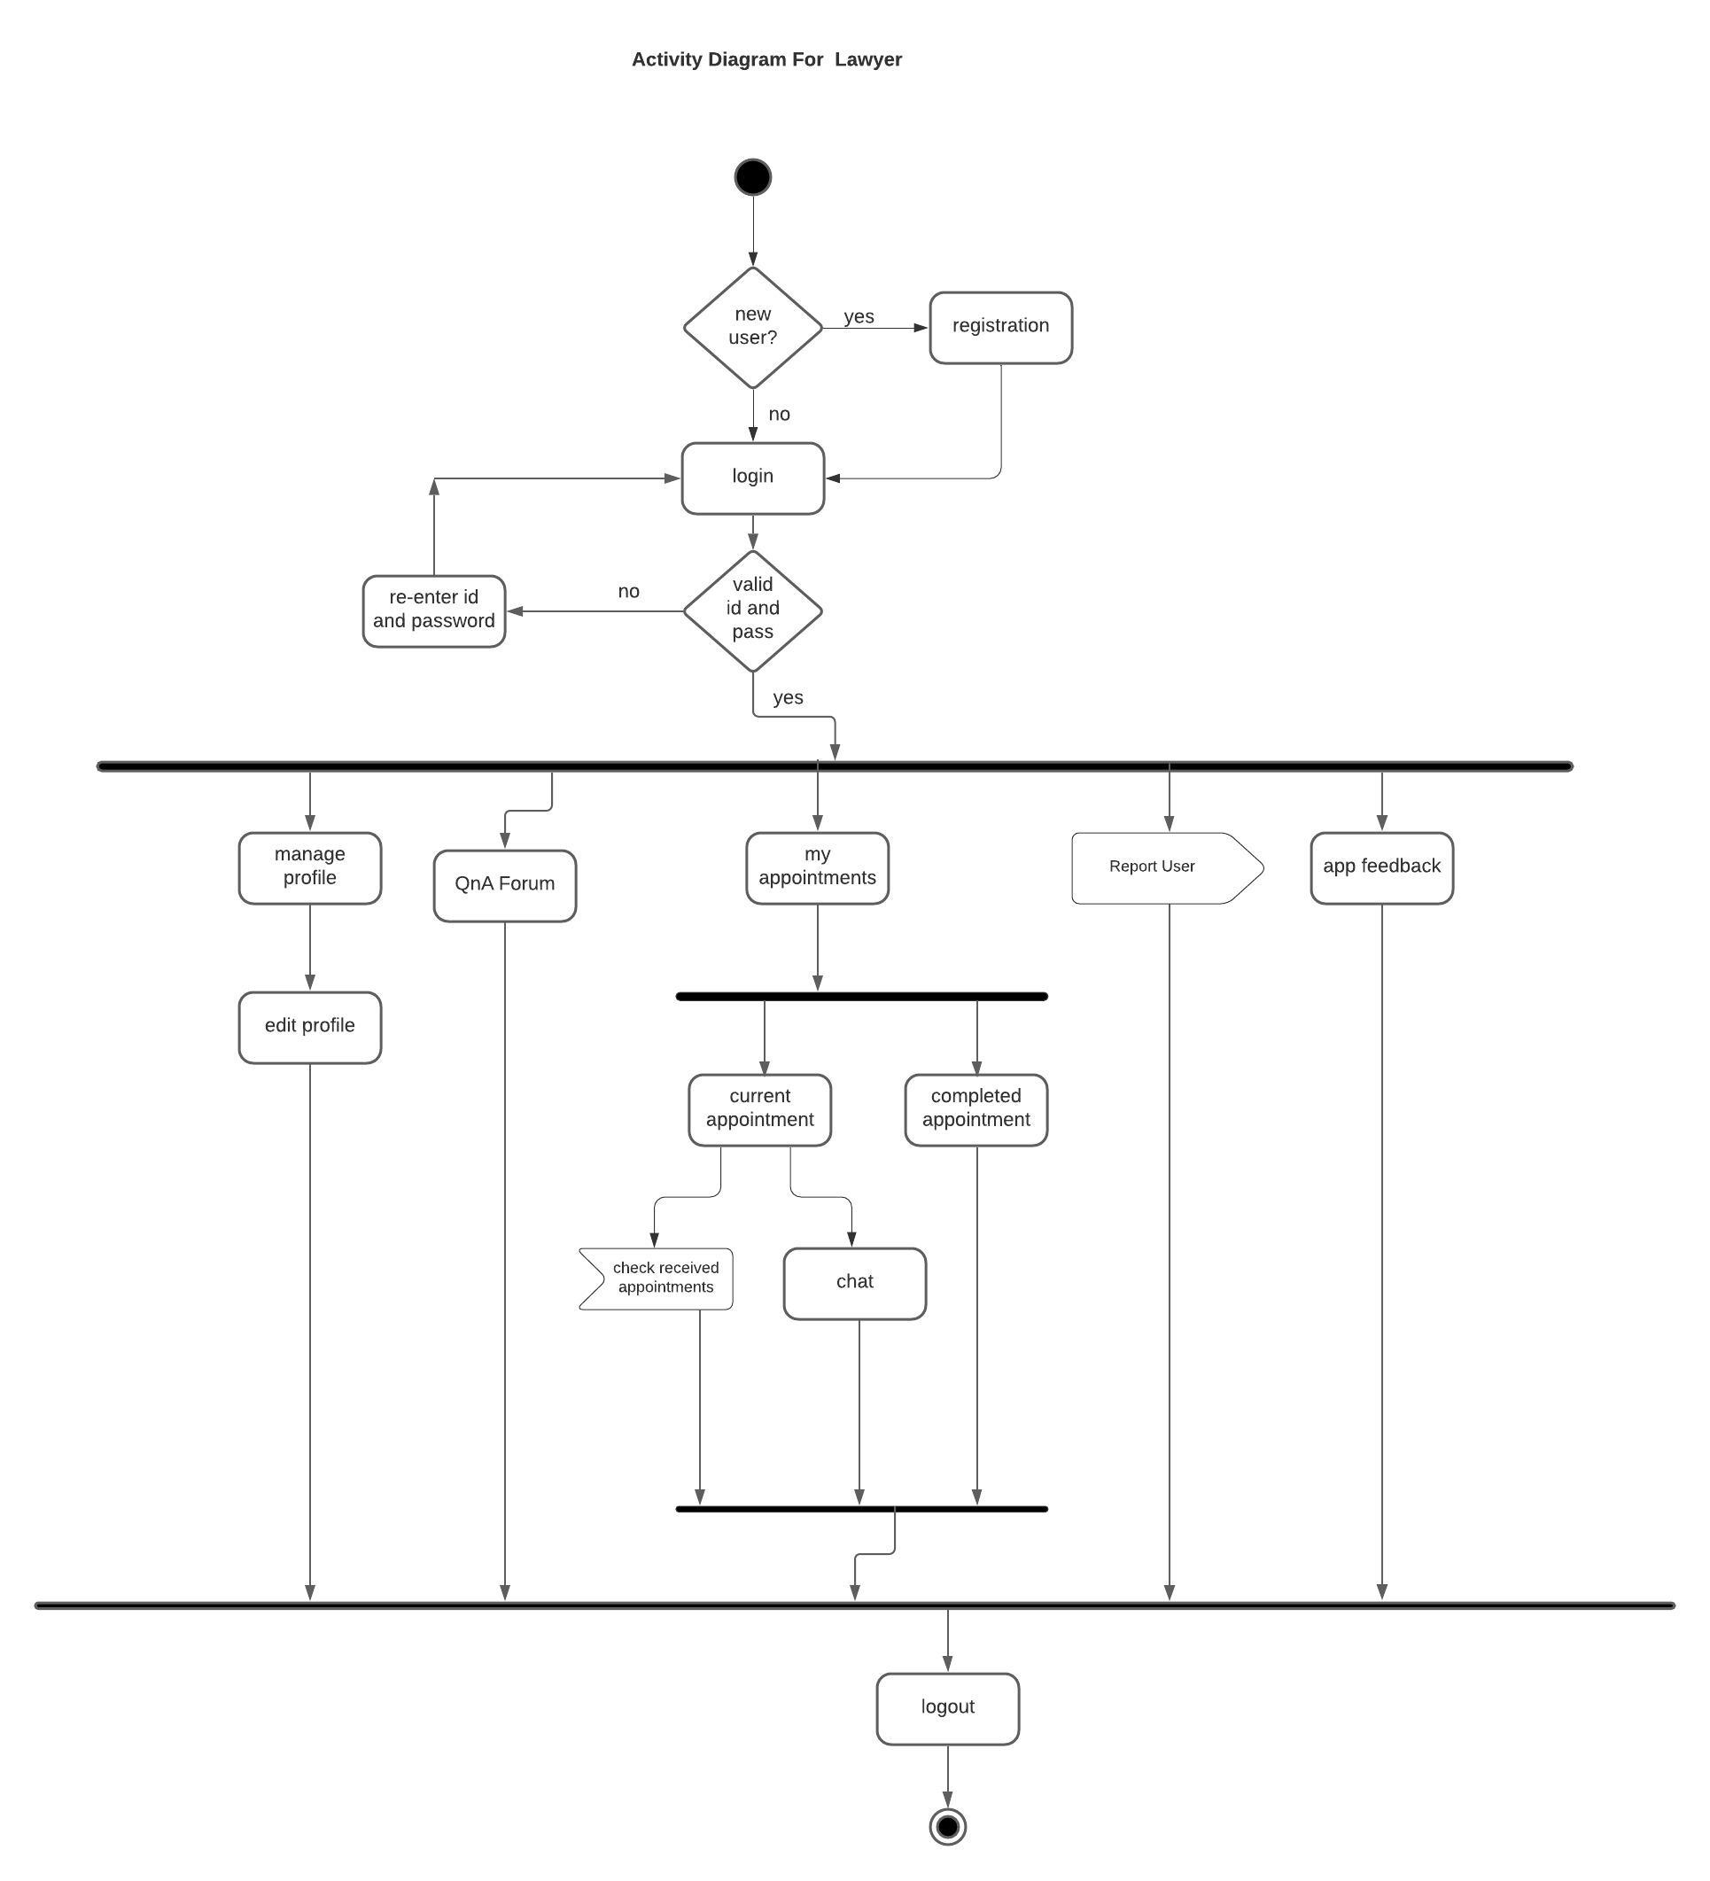
Activity Diagram For Lawyer

Slide 12
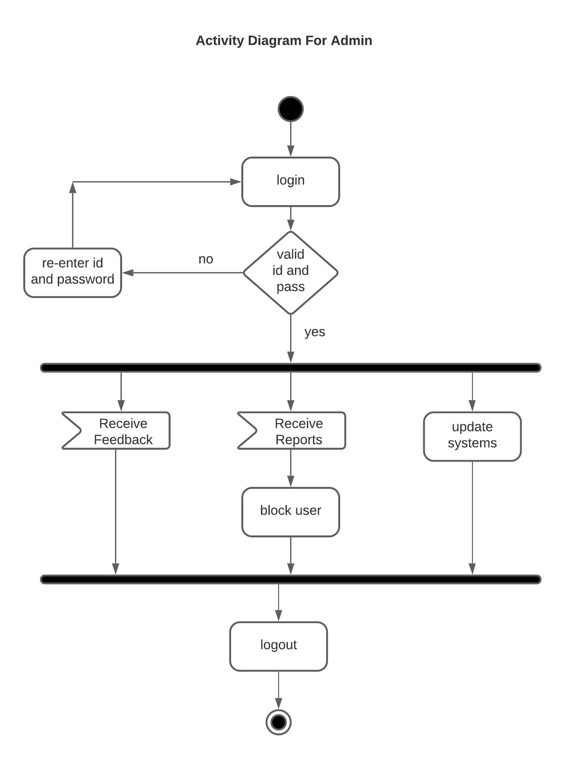
Activity Diagram For Admin

Slide 13
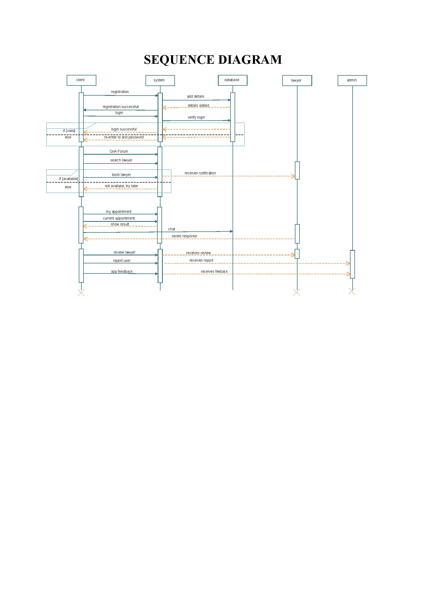
Sequence Diagram

Slide 14
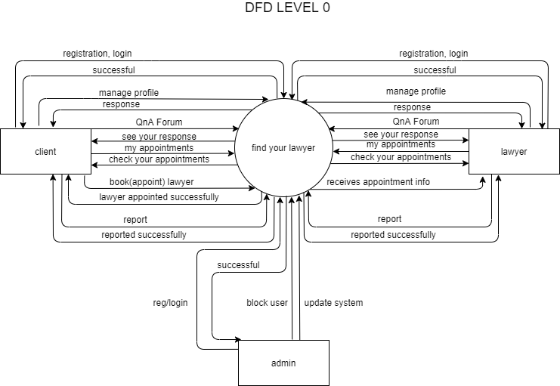
DFD Level 0

Slide 15
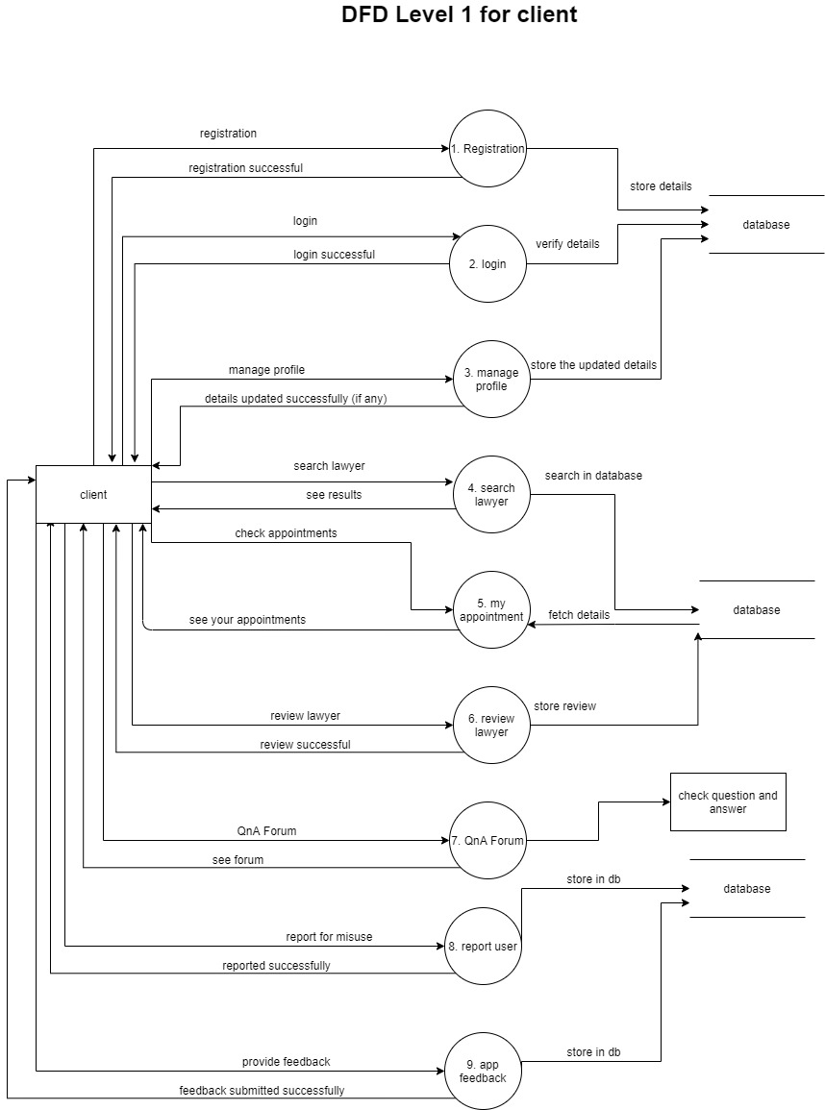
DFD Level 1 Client

Slide 16
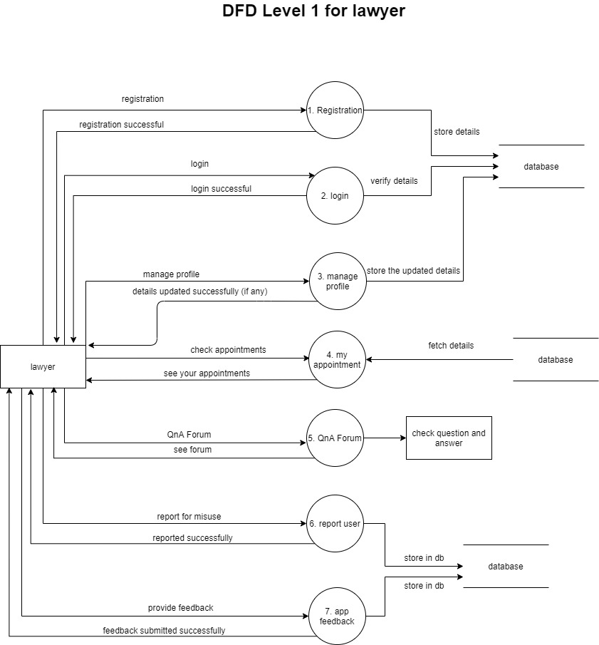
DFD Level 1 Lawyer

Slide 17
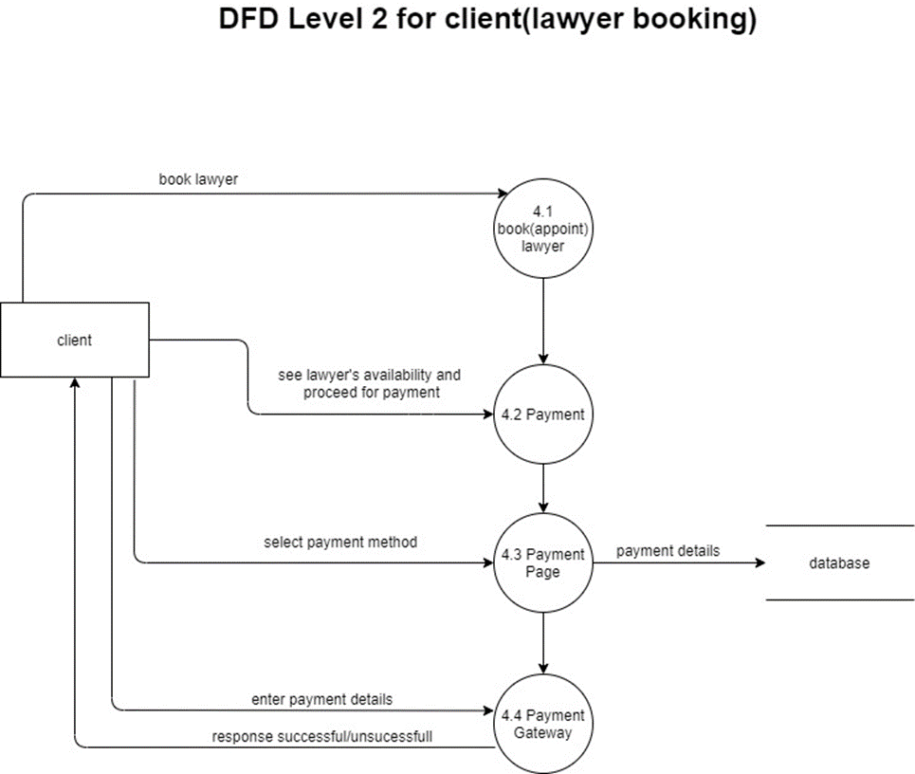
DFD Level 2

Slide 18
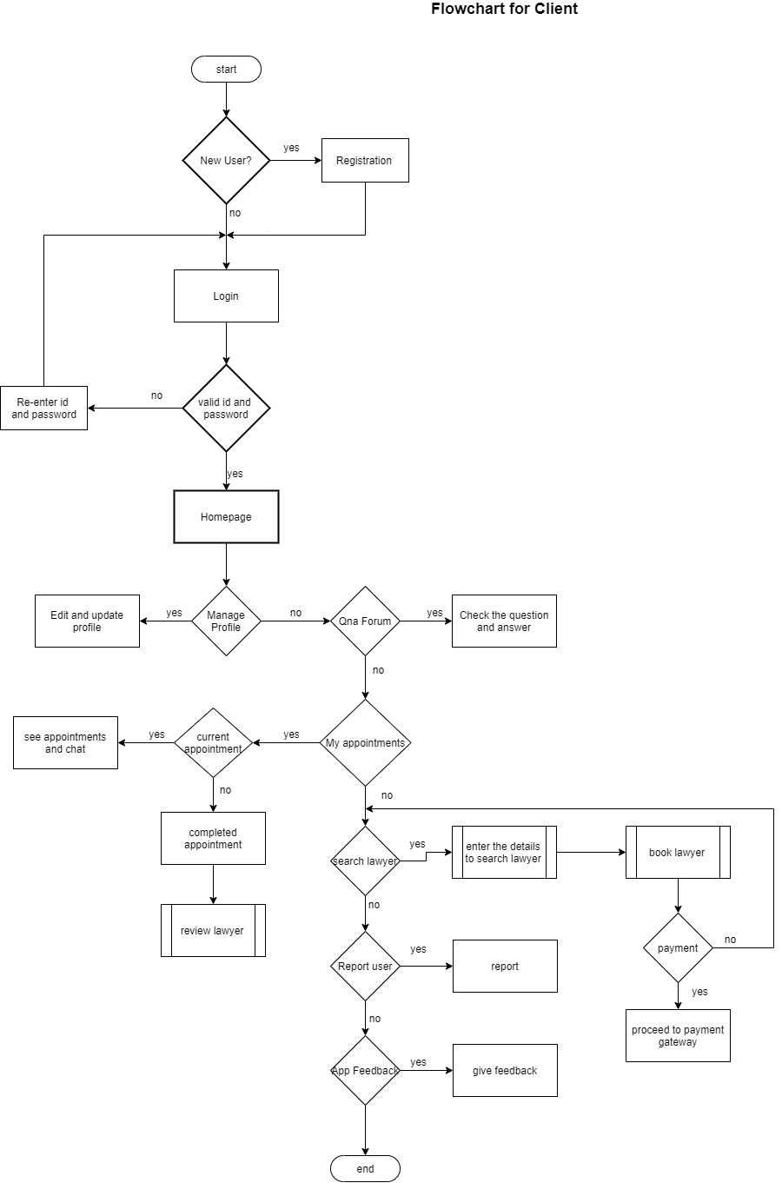
Flowchart for Client

Slide 19
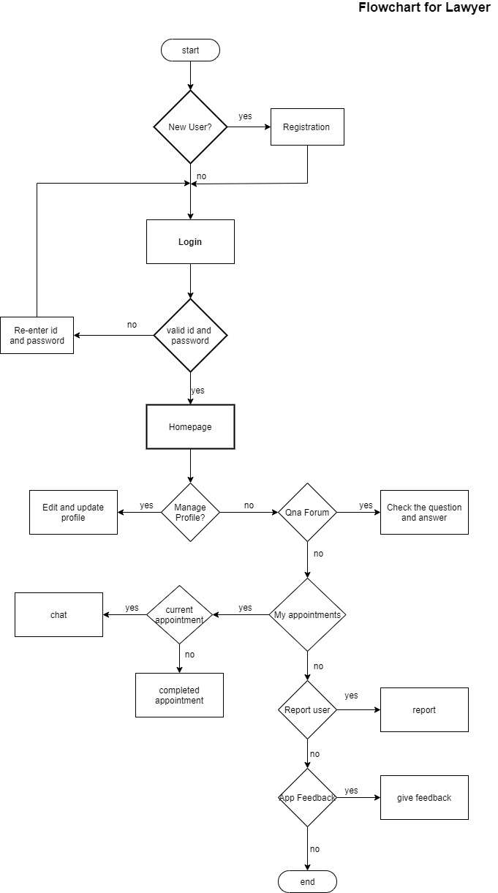
Flowchart for Lawyer

Slide 20
Database Design
Database Schema Design
COLUMN NAME | DATATYPE | DESCRIPTION
u_id | int | primary key autogenerated
full name | varchar | required
gender | varchar | required
address | varchar | required
city | varchar | required
state | varchar | required
mob. no. | int | required
email id | varchar | required
COLUMN NAME | DATATYPE | DESCRIPTION
l_id | int | primary key autogenerated
full name | varchar | required
gender | varchar | required
address | varchar | required
city | varchar | required
state | varchar | required
mob. no. | int | required
email id | varchar | required
qualification | varchar | required

Slide 21
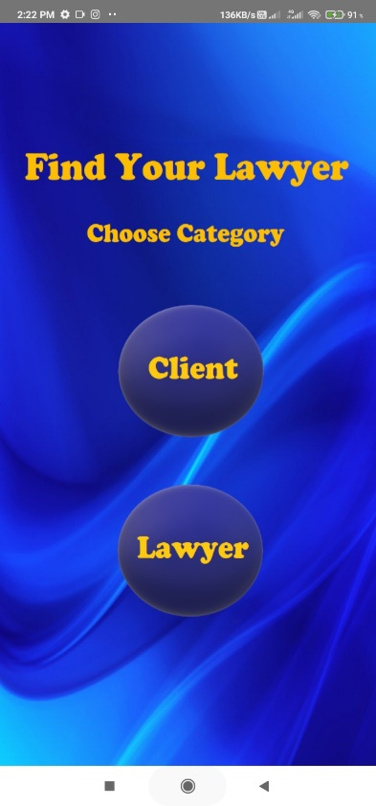
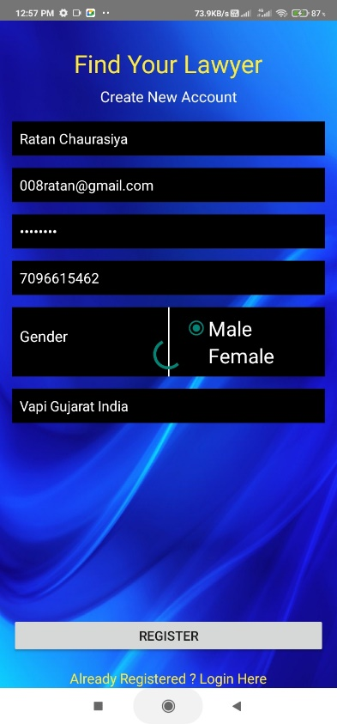
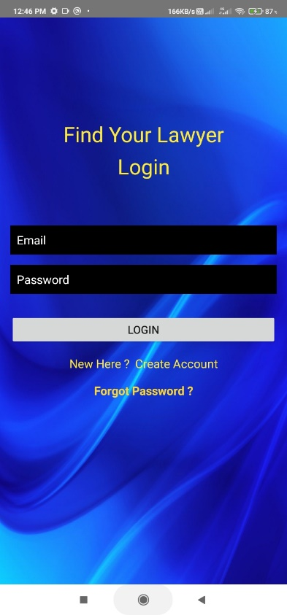
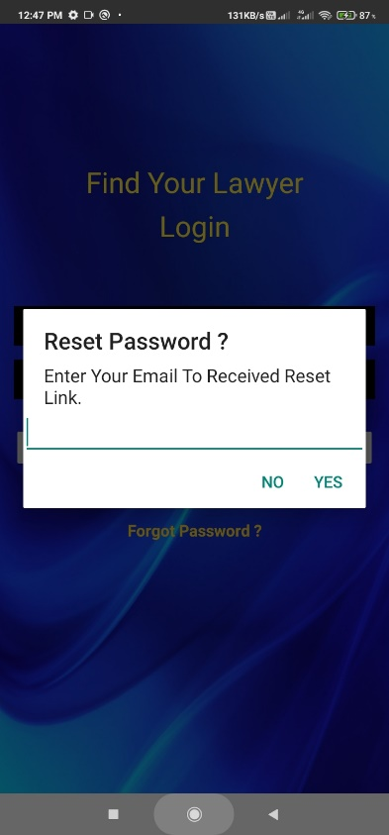
Implementation
Fig. 1 Choose category Fig 2 Registration
Fig. 3 Login Fig. 4 Reset Password
We are implementing this project in Android Studio
We will be using firebase as a database.

Slide 22
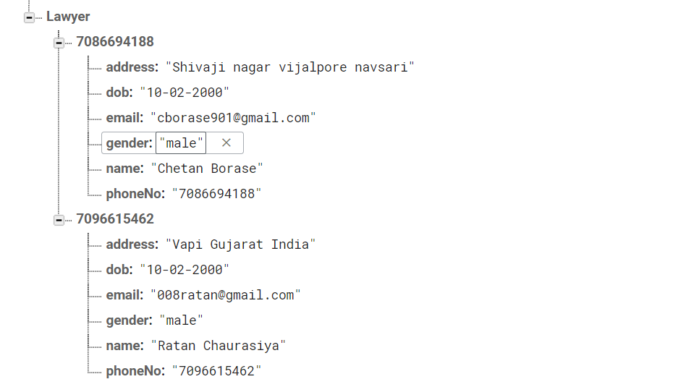
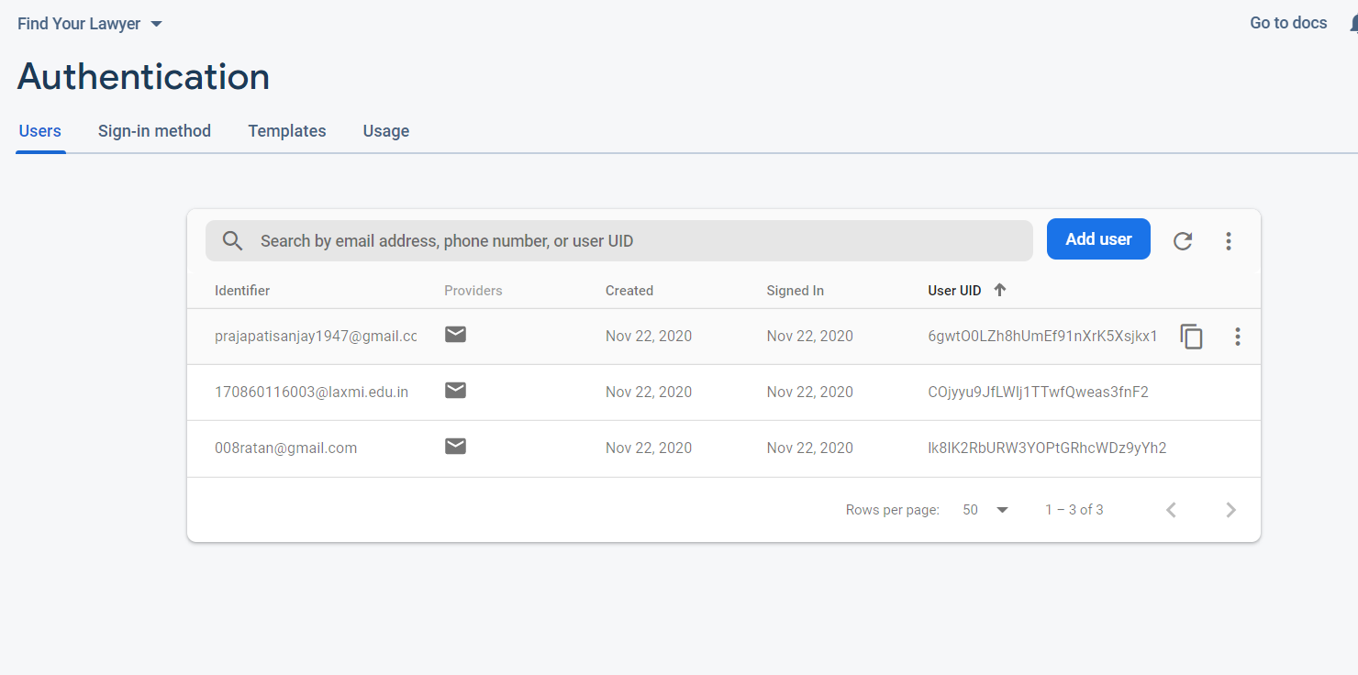
Fig. 5 Database Fig 6 Authentication

Slide 23
Conclusion and Future work
It is an application for lawyers and clients to search for each other digitally. So, it saves time to go here and there and look for a lawyer. In this project, we create login and registration pages using Android Studio and link to the database. We have used the Firebase database and began to design the layouts of other pages of the application.
In the future, we will add lawyer recommendation. We will try to make the app more user friendly and easy to use.

Slide 24
References
1) LAWRATO: https://lawrato.com/
2) LEGALMATCH: https://www.legalmatch.com/
3) VKEEL: https://www.vkeel.com/
3) UML DIAGRAMS: https://www.uml-diagrams.org/
4) ANDROID: https://developer.android.com/guide
5) FIREBASE: https://firebase.google.com/docs/android/setup

Slide 25
Thank you

